Slide 1





Process Mining Virtual Internship
by
K.PUSHPAREKHA
Rollno:224G1A3273
Department of Computer Science and Engineering (Data Science)
Srinivasa Ramanujan Institute of Technology
(Affiliated to JNTUA & Approved by AICTE) (Accredited by NAAC with ‘A’ Grade & Accredited by NBA (EEE, ECE & CSE)
Rotarypuram Village, B K Samudram Mandal, Ananthapuramu – 515701.
2023 - 2024

Slide 2




Contents
Process Mining Virtual Internship
Course Objective
Introduction
Modules
Modules Explanation
Real-Time applications
Conclusion
GitHub Link
SRINIVASA RAMANUJAN INSTITUTE OF TECHNOLOGY

Slide 3



Course Objective
Process Mining Virtual Internship
This course aims to equip learners with the knowledge and skills needed to effectively utilize process mining techniques. Through a combination of theoretical knowledge and practical applications, participants will be prepared to apply process mining in their own organizations, driving continuous improvement and innovation.
Whether you’re a business analyst, IT professional, or process manager, this course will help you harness the power of process mining to transform your approach to process management.
SRINIVASA RAMANUJAN INSTITUTE OF TECHNOLOGY

Slide 4



Introduction
Process Mining Virtual Internship
Process mining is an emerging field at the intersection of data science and business process management. It involves the extraction of insights from event logs generated by various information systems, enabling organizations to visualize, analyze, and improve their processes.
In today’s data-driven environment, organizations are continually looking for ways to enhance operational efficiency and effectiveness. Traditional methods of process analysis often rely on manual documentation and subjective interpretations, which can lead to inefficiencies and inaccuracies. Process mining addresses these challenges by providing a data-centric approach that leverages actual process execution data.
SRINIVASA RAMANUJAN INSTITUTE OF TECHNOLOGY

Slide 5


Modules
Process Mining Virtual Internship
Data Extraction and Collection
Data Pre processing
Event Log Preparation
Process Discovery
Conformance Checking
Performance Analysis
Enhancement and Optimization
Visualization and Reporting
Predictive Analysis
Continuous Monitoring
SRINIVASA RAMANUJAN INSTITUTE OF TECHNOLOGY

Slide 6



Modules Explanation
Process Mining Virtual Internship
1. Process Mining Fundamentals
Process Mining Fundamentals track is structured into three milestones which consist of multiple courses. Those milestones are:
1. Review and Interpret Analyses
2. Build Analyses
Type your text
3. Case Study: Pizzeria Mamma Mia Process Mining Fundamentals interpret process visualizations and identify process inefficiencies:
Conceptualize your process in terms of activities and cases.
Use the Variant Explorer for an overview of all the ways the process is flowing.
Use the Process Explorer to quickly identify undesired activities and see how cases are flowing into and out of individual activities.
Interact with charts and tables to verify your assumptions about how the process is performing and to focus on
attributes of cases reflecting inefficiency.
Leverage Selection Views to filter on cases, even on attributes not visible in Analysis sheets.
Use the Case Explorer to inspect individual cases.
SRINIVASA RAMANUJAN INSTITUTE OF TECHNOLOGY

Slide 7


Modules Explanation
Process Mining Virtual Internship
Rising Star- Technical:
Technical process mining typically refers to the application of process mining techniques to analyze and optimize technical processes these process can include software development it service management, manufacturing logistics and other technical activities.
Software development analyzing the software development life cycle to identify areas where code review processes are causing delays or base 13 steps are frequently skipped.
IT service management analyzing the incident management process to identify bottlenecks in resolving technical issues and ensuring timely responses to user request.
Manufacturing analyzing the manufacturing process to identify areas where production is slowing
down due to mission breakdowns are in efficient resource allocation. iv. Logistics Analyzing the logistics process to optimize roots delivery schedules and inventory management.
SRINIVASA RAMANUJAN INSTITUTE OF TECHNOLOGY

Slide 8

Modules Explanation
Process Mining Virtual Internship
The Rising Star Technical track is structured into two milestones which consist of multiple courses. Those milestones are:
*Get Data into EMS
*PQL Queries
1. Get Data into EMS:
*To get into the EMS (Enterprise Management Systems) of process mining as a rising star technical, you would need to focus on developing your skills and knowledge in process mining techniques and tools. Start by familiarizing yourself with the fundamentals of process mining, such as data extraction, process discovery, and process analysis.
*The Execution Management System (EMS) reveals and fixes process inefficiencies.By connecting your data across systems, apps, and desktops, it x-rays your company's entire business operation, showing you how your business really works.
SRINIVASA RAMANUJAN INSTITUTE OF TECHNOLOGY

Slide 9

Modules Explanation
Process Mining VIrtual Internship
2) PQL Queries
* PQL(Process Query Language) queries in process mining allow you to extract specific information from event logs. With PQL, you can ask questions about your process, such as
finding the most common paths, identifying bottlenecks, or analyzing the performance of certain
activities
*PQL queries are written in a specialized language that is designed to interact with process mining tools. These queries typically involve filtering and aggregating events based on specific criteria. For example, you can use PQL to select events that occurred within a certain time frame, events related to a specific case or activity, or events that meet certain conditions
SRINIVASA RAMANUJAN INSTITUTE OF TECHNOLOGY

Slide 10


Real time applications
Process Mining Virtual Internship
Supply Chain Optimization
Healthcare Process Improvement
Manufacturing Process Analysis
Financial Transaction Monitoring
IT Service Management
Logistics and Transportation
Customer Journey Analysis
Energy Management
Emergency Response and Disaster Management
Compliance Monitoring
Retail Operations Optimization
SRINIVASA RAMANUJAN INSTITUTE OF TECHNOLOGY

Slide 11


Conclusion
Process Mining Virtual Internship
In conclusion, process mining is a powerful and versatile technology that offers valuable insights into the inner workings of organizational processes. By analyzing event data generated during the execution of processes, process mining uncovers hidden patterns, identifies inefficiencies, and provides actionable recommendations for process optimization. This technology has the potential to drive improvements across a wide range of industries, including manufacturing, healthcare, finance, logistics, customer service, and more.
SRINIVASA RAMANUJAN INSTITUTE OF TECHNOLOGY

Slide 12



References
Process Mining Virtual Internship
[1] Ref website:
https://academy.celonis.com/learningpaths/execution- management .
[2] Execution management link: https://tinyurl.com/2pvuuzmd .
[3] Login page : https://academy-login.celonis.com/s/login/ .
SRINIVASA RAMANUJAN INSTITUTE OF TECHNOLOGY

Slide 13


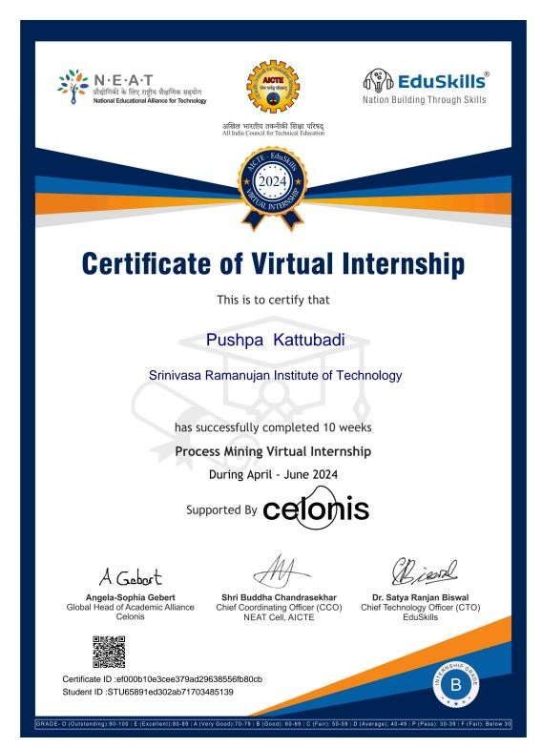

Internship certificate
Process Mining Virtual Internship
SRINIVASA RAMANUJAN INSTITUTE OF TECHNOLOGY

Slide 14

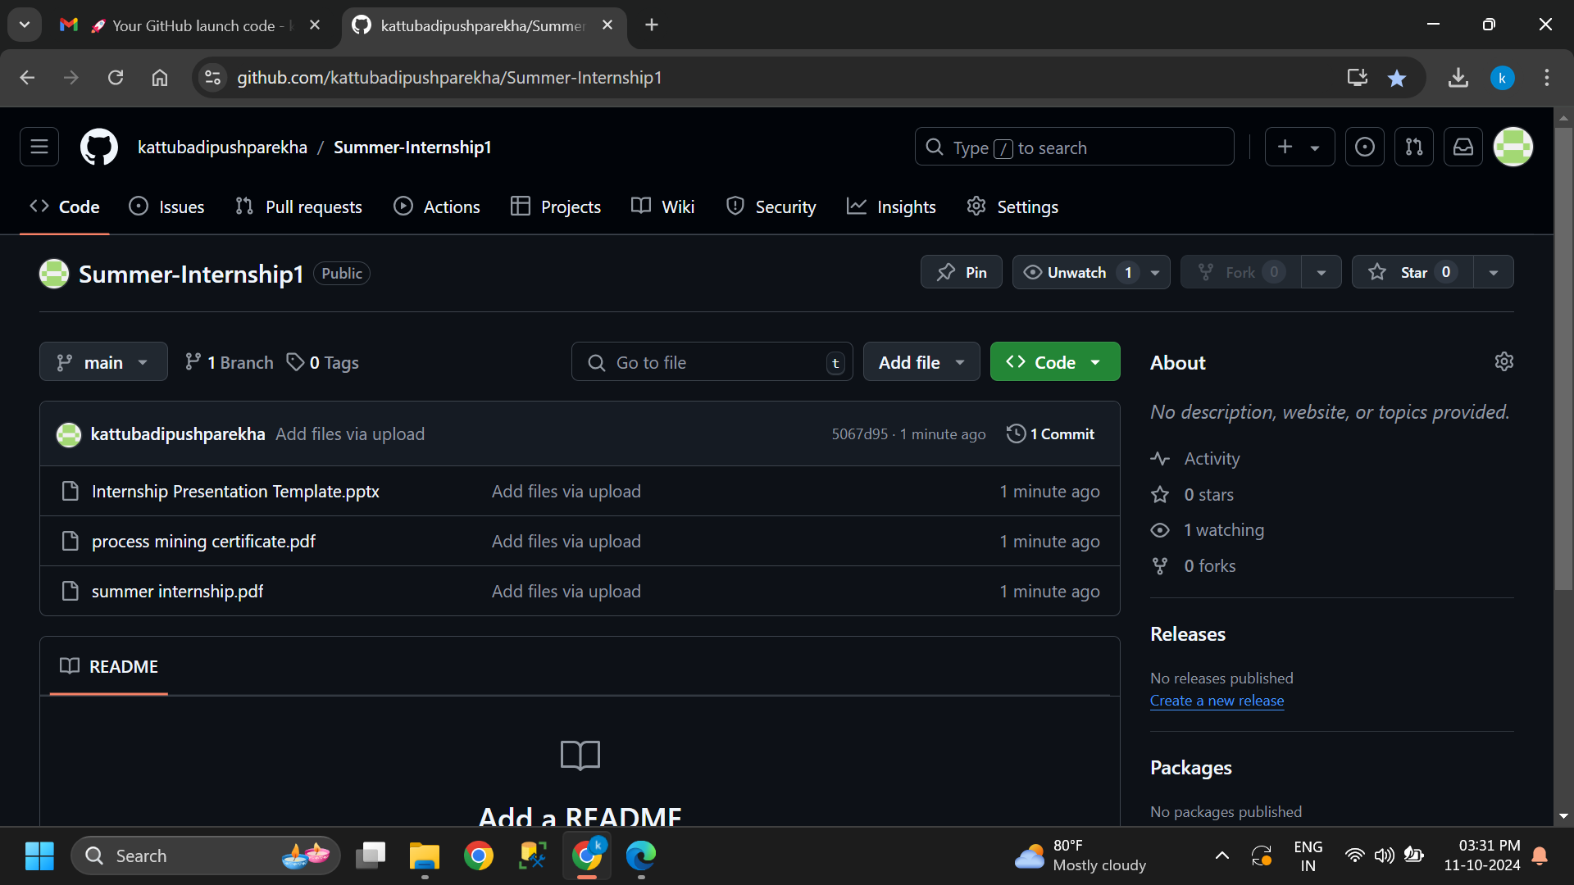

Git Hub Dashboard
Process Mining Virtual Internship
Repository Name Like: Summer Internship - I
Under that include document, presentation and Certificate(Pdf).
SRINIVASA RAMANUJAN INSTITUTE OF TECHNOLOGY

Slide 15


Thank You!!!
Process Mining Virtual Internship
SRINIVASA RAMANUJAN INSTITUTE OF TECHNOLOGY

